Slide 1
HELP ME WITH MY ADR!
Calculating the MANDATORY COST SHARING AMOUNT =
Mandatory Cost Sharing amount
=
# pay periods of that funding period in the FY
Effort on the grant period
x
x
( Real Salary – Sponsor salary cap)
total # pay periods in the FY
If you don’t have that information, but know which salary cap was used, you can figure it out. See slide 2.
1

Slide 2
HELP ME WITH MY ADR!
Finding the effort on the grant period from the Salary cap used on the WBS account
Salary wage charged on that period
total # pay periods in the FY
x
Effort on the grant period
=
# pay periods of that funding period in the FY
Sponsor salary cap on that period
x
2

Slide 3
HELP ME WITH MY ADR!
Calculating the Adj % age = ratio of [ ( salary wage + cost sharing amount) / Annual IBS] x 100 and also = annual effort average of the PI on the grant associated with the WBS account or fund on that line
Salary Wage charged to the WBS/ fund
Cost sharing amount associated to the WBS/ fund
+
Adj % age =
Total Base Salary
And that should give you the same result:
# pay periods of that funding period in the FY
Effort on the grant period
Adj % age =
x
total # pay periods in the FY

Slide 4
HELP ME WITH MY ADR!
Extra tips
The cost sharing column dollars amounts should add up to $0, considering that all your mandatory cost sharing amounts should come from a discretionary fund (and not a federal fund) and that should be clear. (See arrow 1 on the ADR example on slide 5)
Make sure that the % indicated in the “Adj % age” column is not below the minimum effort that the PI should be reporting to the NIH based on the calculation “salary wage / NIH salary cap”. (See arrow 2 on the ADR example on slide 5).
Your last Adj% age column should add up to 100% (See arrow 3 on the ADR example on slide 5).
For effort compliance, your faculty members absolutely need to have at LEAST 2% effort paid from a fund, or even 10% if they are chairman, as per our Effort policy. (See arrow 4 on the ADR example on slide 5)
If your faculty did some Voluntary cost sharing ( by charging the whole cost of their effort to a discretionary fund) you need to add a line with that information (See arrow 5 on the ADR example on slide 5)

Slide 5
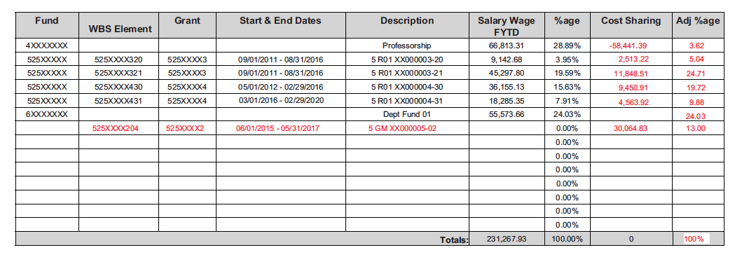
HELP ME WITH MY ADR!
How your ADR can look
4
2
5
4
1
3
2
$36,155.13 / $184,200 = 19.628 %
Because
NIH Salary cap until 01/09/2016 = $ 183,300
NIH salary cap after 01/10/2016 = $185,100
average on the FY 16 = $184,200

