Slide 1
RAPID Meeting
May 2017

Slide 2
Unified Annual Laboratory Inspection

Slide 3
Historical Laboratory Research Safety
EHS Research Safety Checklist
Defined / limited focus on chemical safety, FDNY / fire safety, general laboratory safety, hazardous materials shipment and emergency preparedness.
Required annual completion and submission by Principal Investigator (PI).
Institutional Biosafety Committee
Defined / limited focus on biological safety involving rDNA and Risk Group 2-4 biological agents.
IBC Registration required for each separate pre-award grant submission/approval.
Each registration had a separate compliance due date.
Compliance issues identified as “new” research is conducted prior to grant submission/IBC Registration.
Radiation
Safety Committee
Defined / limited focus on non-human use of radioactive materials.
Non-human use radiation usage requires initial registration and authorization. New isotope usage requires amendment.
Separate annual confirmation of continued authorized user status.

Slide 4
2015 Unified Laboratory Safety Registration
Unified Laboratory Safety Registration
(EHS Research Safety Checklist / IBC Registration / Radiation Safety)
Combines chemical, biological, and radiological safety into one comprehensive “Laboratory Safety Registration” submittal.
EHS meets with Principal Investigator (and/or laboratory safety coordinator) to review current and proposed research and takes the lead to prepare documentation.
EHS submits documentation to Safety Committees with Principal Investigator’s authorization. Safety Committees perform full review. The pre-review greatly reduces or eliminates administrative and scientific issues identified by Safety Committees.
Laboratory Safety Registration will continue to be submitted on a bi-annual basis.
Single comprehensive review and annual inspection of the laboratory for all PIs associated with the laboratory suite to minimize redundant inspections of same physical spaces.

Slide 5
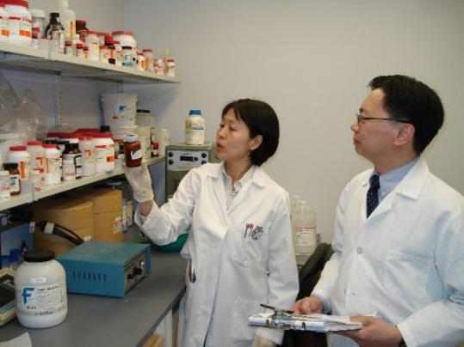
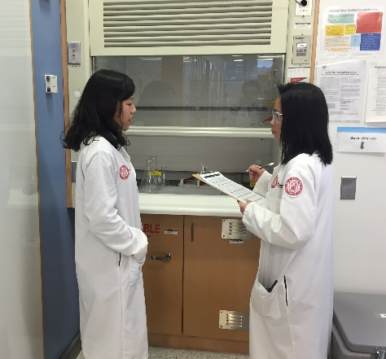
2016: Unified Safety Review and Inspection
Unified Laboratory Safety Review and Inspection
(EHS Research Safety Checklist / IBC Registration / Radiation Safety)
Combines chemical, biological, and radiological safety annual reviews and inspections.
Annual Review:
High hazard chemical, biological and radiological hazards used in the laboratory.
Safe work practices and waste management.
Safety equipment (chemical hoods, biosafety cabinets, radiation survey meters, oxygen monitors).
Safety training.
When: align same month Registrations are completed.
Follow-up: EHS will work with LSCs to address issues.

Slide 6
Unified Laboratory Inspection Program
Total PIs | Percent
276 | 100.0%
203 | 73.6%
52 | 18.8%

Slide 7
Top Inspection Findings
All Safety Programs
Chemical Safety
Biological Safety
Radiation Safety

Slide 8
Departmental Safety Summary Report (FY18)
Laboratory Safety Summary Report
Principal Investigator-specific report with comprehensive safety and training information and review of past violations, inspections and accidents.
Currently available via the Weill Business Gateway.
Departmental Safety Summary Report (FY18)
Proposed for FY18 after full one-year inspection cycle completed.
Department-level report with summary of safety and training information and review of past violations, inspections and accidents.

Slide 9
Upcoming NYCDOH Radiation Inspection

Slide 10
2017 Biannual NYCDOH Radiation Inspection
Unannounced Inspection – Anytime in 2017
Communication and Assistance
Broadcast email to Principal Investigators and Laboratory Safety Coordinators.
EHS Safety Advisor visits to laboratories to check for correctable issues.
Self-Audit guide of common radiation related violations with corrective action.
Inspection
DOH typically inspects 20% of laboratories.
Inspectors accompanied by EHS and require assistance from laboratory.
Fines are possible for multiple serious violations but must proceed through an administrative tribunal process.
Notes:
WCM is expecting an inspection before the end of the year, without prior notice. The NYS Department of Health usually meets with EHS and the Radiation Safety Committee, and begins the formal examinations within a few days.
After this meeting, EHS usually takes immediate measures, such as sending a broadcast email and visiting labs for any issues that can be corrected before the inspection. It is important to note that missed wipe tests and other protocols may not be corrected in time due to time constraints.
The Laboratory Self-Audit Checklist for Isotope Users can assist with compliance as it lists common violations.
Though the DOH usually inspects a fifth of the labs, the process may be extended to more facilities if they find consistent violations. If most of these minor issues are corrected, inspections should go smoothly and administrative fines will not be issued.

Slide 11
Preparing for DOH Radiation Inspection
NYC Department of Health inspects Laboratories every 2 years.
Top 4 areas of concern for DOH:
Contamination Control
Monthly wipe testing
Survey meter calibration
Inventory Control
Central Isotope Laboratory (CIL)
Laboratory use records
Waste Control
Proper containers
Compliant labeling
Security
Laboratories locked when no one is present
Secured access to high activity sources
Control of ordering process
Notes:
The top areas of concern during DOH inspections are matters that should be considered on a daily basis, and laboratories that incorporate these matters into routine operations usually have successful inspections.
It is important to note that laboratory violations are public record. This information can be used to deter plans to expand facilities, which has occurred at other institutions.
To ensure compliance, laboratory staff must:
Perform monthly wipe tests
Calibrate survey meters yearly
Avoid food waste in laboratory areas
Maintain accurate inventory of all radioactive materials and their use
Follow procedures when ordering isotopes
Label all containers
Make sure laboratories are locked when no one is present.
Wipe tests must be performed monthly and survey meters should be calibrated once a year.

Slide 12
Autoclave Incident Lessons Learned
Notes:
This section will provide an overview of the EHS Unified Annual Laboratory Inspection Program.

Slide 13
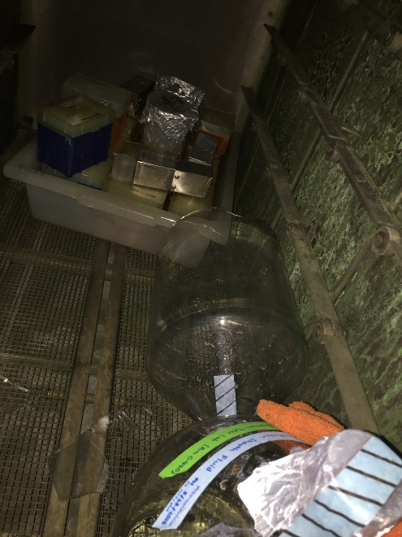
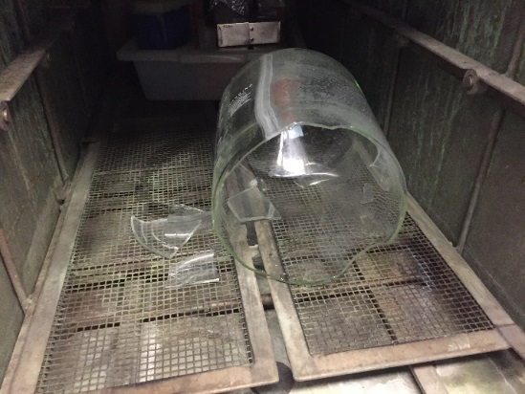
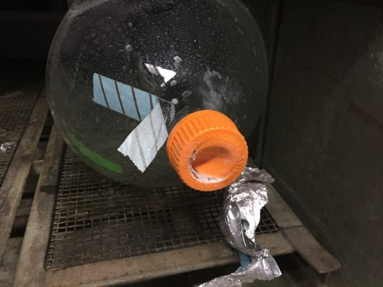
Accident Summary
March 2017
Laboratory Technician opened autoclave
recently completed autoclave cycle
4L bottle of PBS ruptured
~4 liters of heated liquid poured on to lower body and legs.

Slide 14
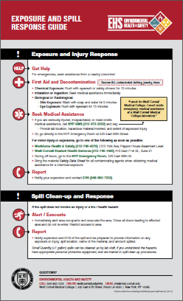
Lessons Learned
What went right?
Lab staff acted quickly to minimize harm and get assistance.
Why did this happen?
Bottle caps not check to confirm loose before autoclaving.
Personal Protective Equipment (e.g., lab coat, face protection, slash apron) not worn.
Secondary containment not used.

Slide 15
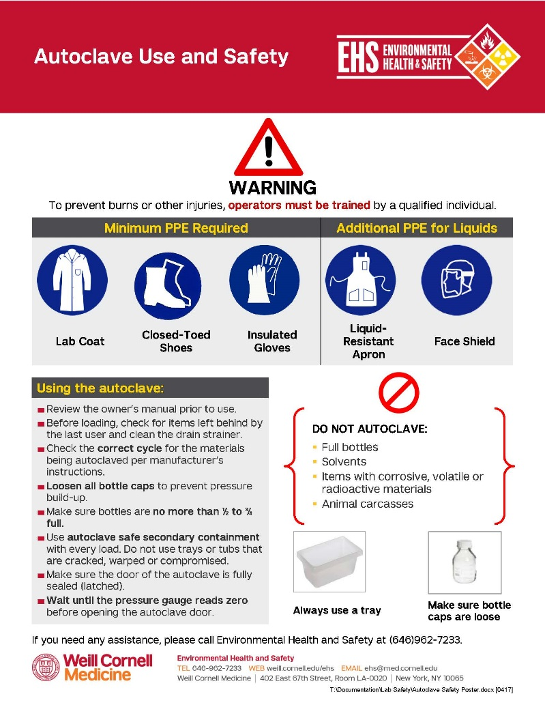
Training
Autoclaving is considered a laboratory operation
Supervised by an FDNY C14 certificate holder.
Autoclave technicians on laboratory rosters
Laboratory or Clinical Safety Training required annually.
Supervisors must train users on proper operation of the unit.
Autoclave owners manual
EHS Update - Autoclave Safety

Slide 16
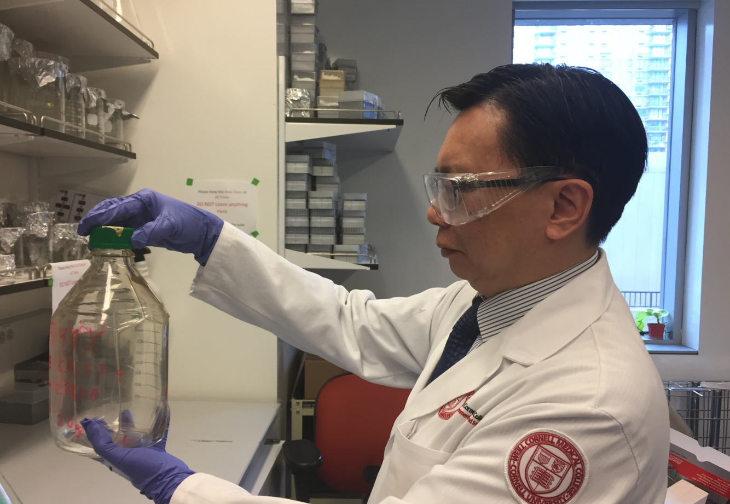
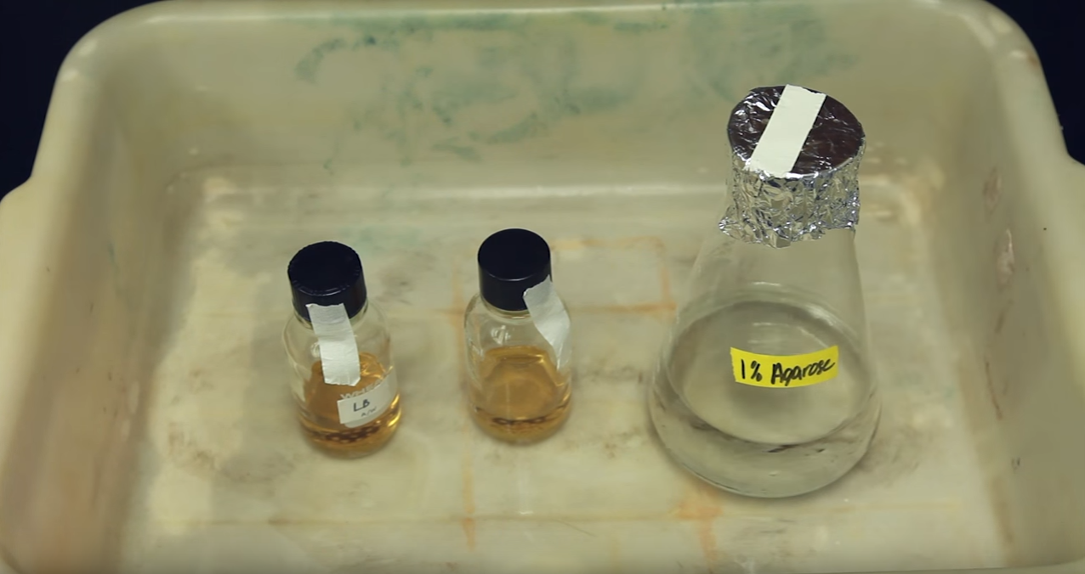
Loading the Autoclave
LOOSEN CAPS TO RELEASE PRESSURE: Prevent bottles from shattering during pressurization by loosening container caps before loading.
ALWAYS USE SECONDARY CONTAINERS: Never put individual glassware pieces directly on the autoclave bottom or floor.
USE AUTOCLAVE-SAFE CONTAINERS: Only use autoclave-compatible plastics. Certain plastics cannot be autoclaved.
DO NOT OVERFILL BOTTLES: Fill only ½ to ¾ full.

Slide 17
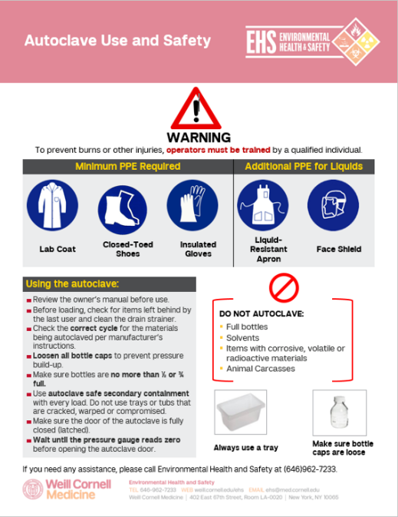
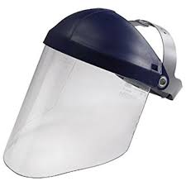
Autoclave Safety Next Steps
Ensure autoclave technicians are registered on laboratory rosters.
Know the location of nearest safety shower and eyewash station.
Review the owner’s manual and EHS Update – Autoclave Safety.
EHS is placing signage, aprons, face shields and new thermal gloves in all autoclave locations.
Contact EHS for additional assistance if necessary.

Slide 18
Questions?

